Slide 1
MULTIPLE BREAK REBAR
Advisor : Prof. K.C.Chang
Presenters : You-Ran Nai

Slide 2
OUTLINE
QUESTION REPLY
PAPER PROGRESS
PAPER REVIEW

Slide 3
OUTLINE
QUESTION REPLY
PAPER PROGRESS
PAPER REVIEW

Slide 4
Incremental Dynamic Analysis with Multi-Modes for Seismic Performance Evaluation of RC Bridges
Prakit Chomchuen, Virote Boonyapinyo
Engineering Structures
February 2017

Slide 5
AUTHOR
UNIVERSITY
Prakit Chomchuen, Virote Boonyapinyo
Department of Civil Engineering, Faculty of Engineering, Thammasat University, Rangsit Campus, Klong Luang, Pathumthani 12120, Thailand
Notes:
法政大學

Slide 6
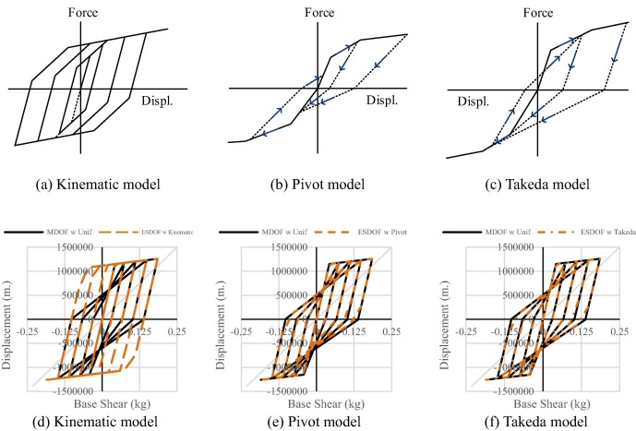
HYSTERESIS
Notes:
遲滯迴圈的模擬用程式內建的參數並不太準
對，paper 是使用模型自動產生的參數
這部分因為之前都沒看過，還要多看 paper 補齊這方面的知識
王柄雄學長

Slide 7
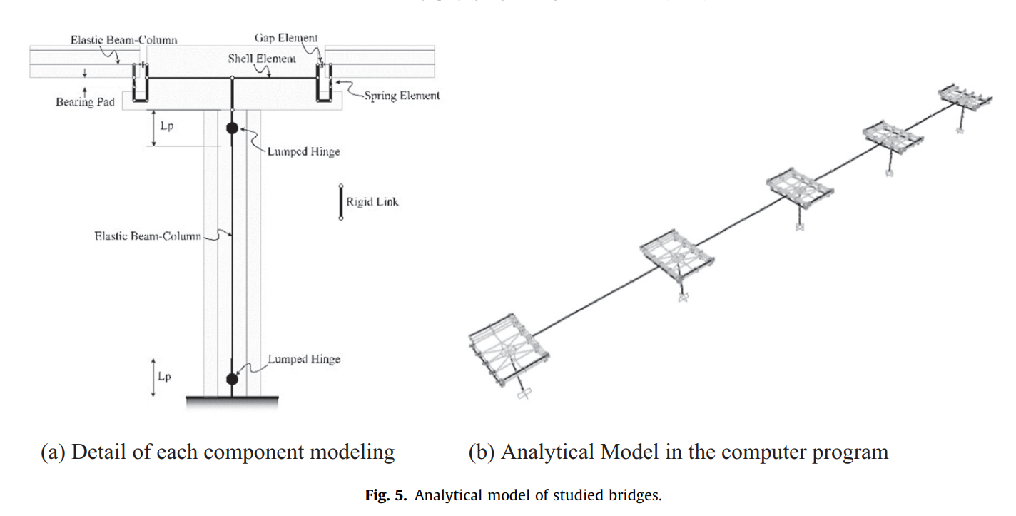
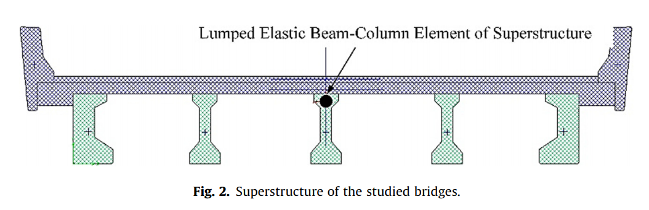
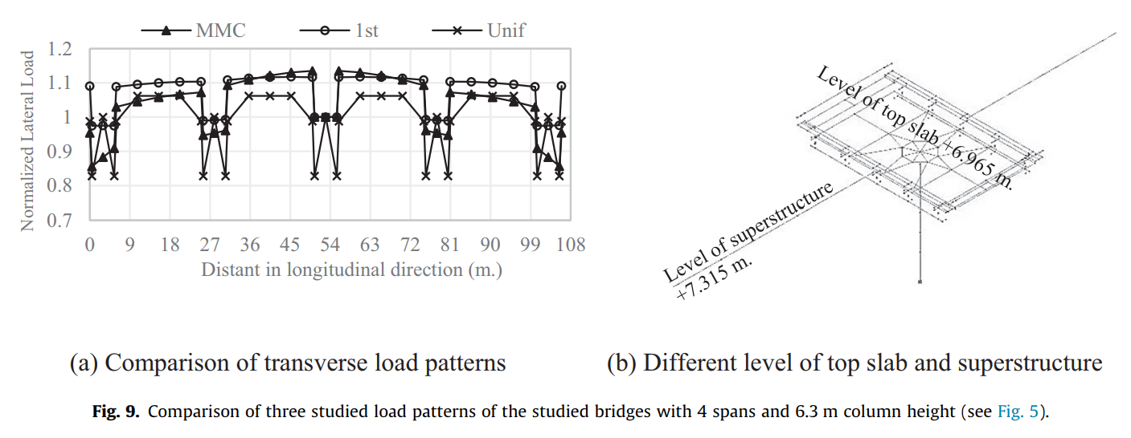
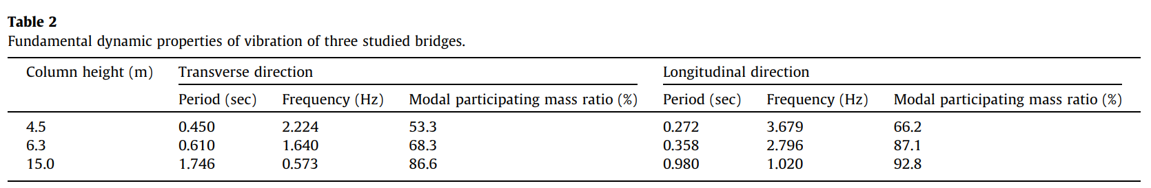
THREE BRIDGES
4 spans, 6.3m column height

Slide 8
OUTLINE
QUESTION REPLY
PAPER PROGRESS
PAPER REVIEW

Slide 9
OUTLINE
1
2
3
4
FROM EXISTING REBAR
ETABS/SAP DEMAND
MULTI-MODES PUSHOVER
NONLINEAR TIME HISTORY ANALYSIS
Notes:
# Outline
為了達到以上的目標，我們把問題拆解為幾個步驟。
- 第一步是依據現有的配筋做優化。
- 第二步是以 ETABS 真正的需求，而不再是現有的配筋。並再加上剪力的部分。
- 第三步是做非線性靜力的部分，由於以上都是線性的推估，如果進入到非線性，行為是否還是我們所預期的，然後由於想要包含高樓層的部分，所以需要研究靜力高模態的狀況。
- 第四步是做非線性動力分析。

Slide 10
LINEAR - FROM EXISTING REBAR
1
2
3
4
5
MOMENT DIAGRAM
TENSION DEVELOPMENT LENGTH
GRAVITY DEMAND
LOAD PATTERN
REDUCE TO THREE / FOUR POINTS
Notes:
- 推估的演算法是用彎矩圖，上層筋以地震力，下層筋以重力與地震力進行多點斷筋。
- 並加上精算法的延伸長度。
- 手動輸入 Gravity 需求。(忽略帶寬、不平均)
- 手動輸入 Gravity 負彎矩偏差比例。Load Pattern Fix fix , fix pin , pin-fix , pin-pin
- 由無限斷筋縮減到有限點斷筋(3 點或 4 點) - 排列組合、分群演算法。

Slide 11
GRAVITY DEMAND
TOP LEFT
TOP RIGHT
LINEAR ADD
(EQ Demand)
(EQ Demand)
GRAVITY DEMAND
EQ DEMAND
BOT LEFT
BOT RIGHT
(EQ Demand)
(EQ Demand)
REVERSE ENGINEERING
➔ ACTUAL DEMAND
GIVEN INFORMATION
Notes:
像是 如果知道這條重力曲線的話
再加上四個配筋點
那其實很多曲線就可以逆推出來了
以上層筋為例
配筋點 – 重力 = 地震力
下層筋就直接是地震力
所以地震力和重力就出來了
那就可以回到前面的曲線
我們就可以直接 match 需求了

Slide 12
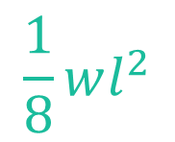
GRAVITY DEMAND
1/12
1/24
SDL LL 版厚 帶寬
1/24
0.9DL
$$\frac{1}{8}wl^{2}$$
1/12
0
1/8
1.2DL+1.6LL
Notes:
太保守了
算出來的反而比原本配的還多
但要怎麼知道這一條重力曲線呢
僅僅只有配筋梁長並不足夠
我們目前指定使用者手動輸入每層樓的
SDL LL 版厚 帶寬
這樣就可以用 $\frac{1}{8}wl^{2}算出$重力曲線
但只僅僅知道這個還不夠
重力需求曲線會隨著束制條件的不同而上下移動
如果都是 pin 兩端為 0
兩端是 fix 的話為 1/12
這個是比較不確定的地方
目前的想法是取保守估計
上層筋重力影響越少越好取 1/12 的一半 1/24
下層筋越多越好取 1/8
還要取載重組合
一樣上層越少越保守取 0.9DL
下層越多越保守取 1.2DL+1.6LL

Slide 13
CASE STUDY
31.6 > 15.3

Slide 14
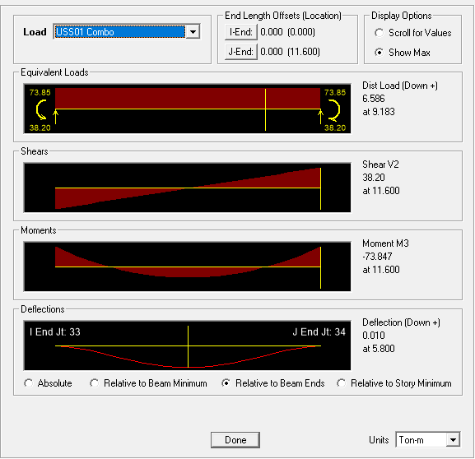
IDEAl CASE
1/12
1/24
1/24
0.9DL
1/12
TOP END: 74 t-m
BOT MID: 37 t-m
0
1/8
1.2DL+1.6LL

Slide 15
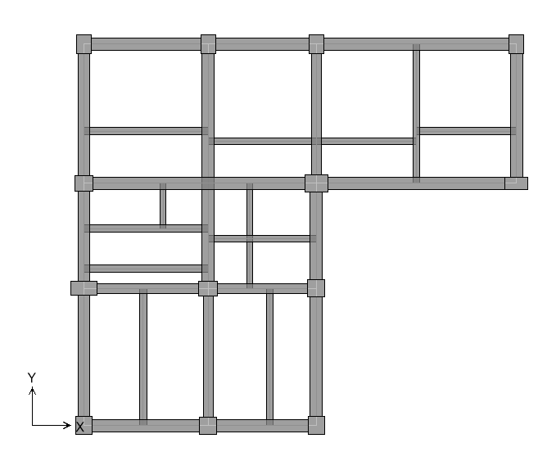
UNIFORM LOAD

Slide 16
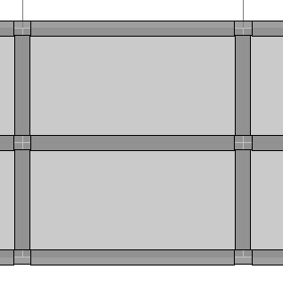
BEAM CONNECTION
MORE BEAMS CASE
TOP END: 74 t-m
BOT MID: 37 t-m

Slide 17
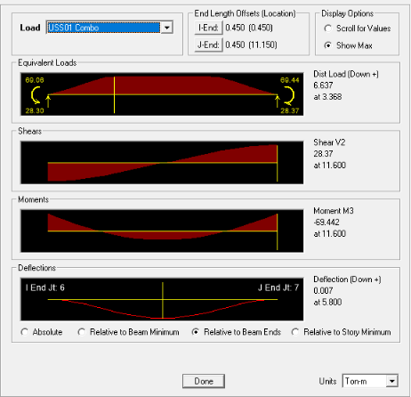
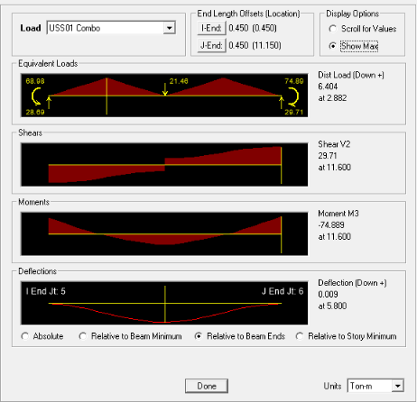
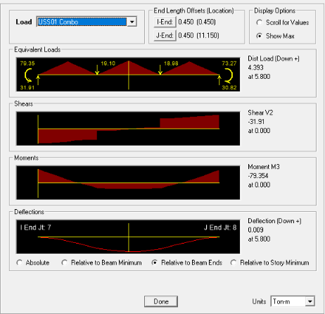
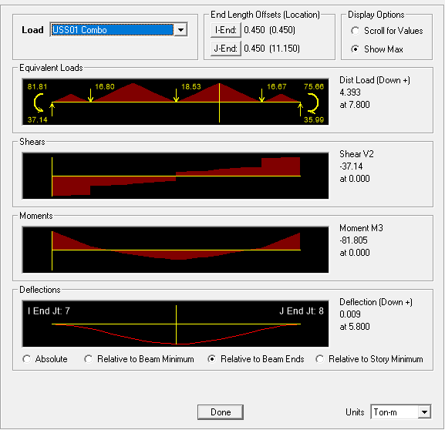
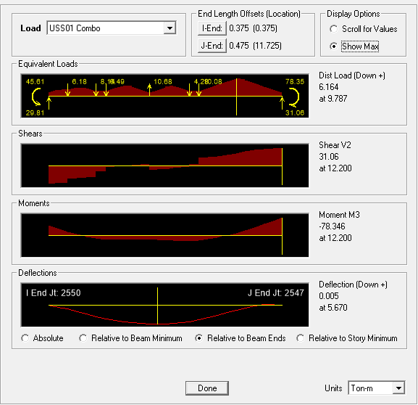
BENCHMARK
74 / 37
70 => 94%
32 => 86%
75 => 101%
44 => 119%
80 => 108%
34 => 92%
82 => 111%
41 => 111%
79 => 107%
22 => 60%
Notes:
均部載重？

Slide 18
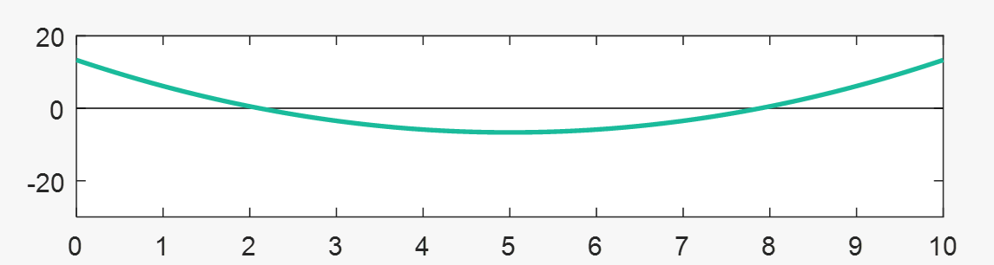
CONSERVATIVE
70 => 94%
1/12
50%
1/24
1/24
200%
1/12
44 => 119%

Slide 19
LINEAR - FROM EXISTING REBAR
1
2
3
4
5
MOMENT DIAGRAM
TENSION DEVELOPMENT LENGTH
GRAVITY DEMAND
LOAD PATTERN
REDUCE TO THREE / FOUR POINTS
Notes:
- 推估的演算法是用彎矩圖，上層筋以地震力，下層筋以重力與地震力進行多點斷筋。
- 並加上精算法的延伸長度。
- 手動輸入 Gravity 需求。(忽略帶寬、不平均)
- 手動輸入 Gravity 負彎矩偏差比例。Load Pattern Fix fix , fix pin , pin-fix , pin-pin
- 由無限斷筋縮減到有限點斷筋(3 點或 4 點) - 排列組合、分群演算法。

Slide 20
RESTRAINTS

Slide 21
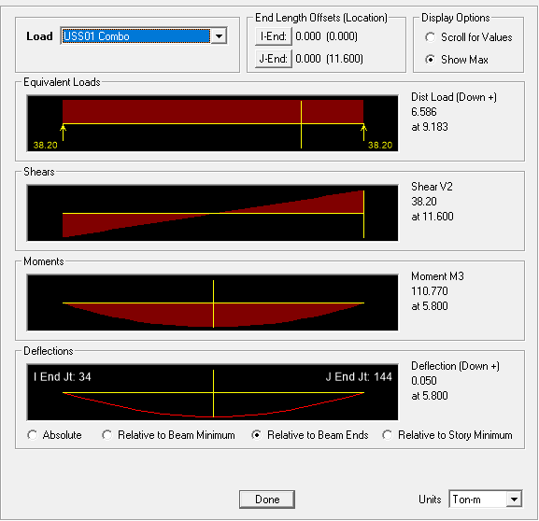
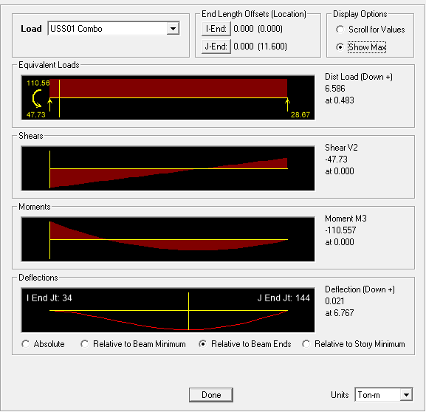
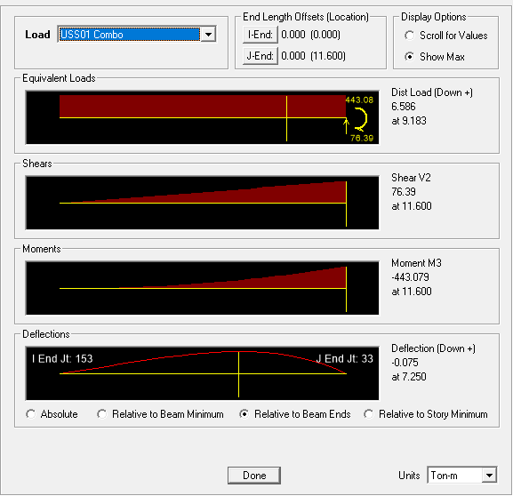
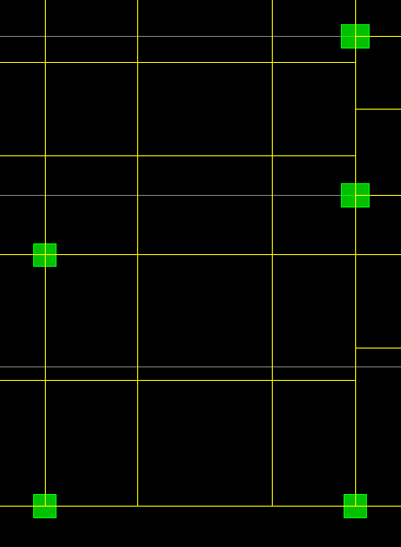
Notes:
束制條件？
差異沉陷？

Slide 22
LINEAR - FROM EXISTING REBAR
1
2
3
4
5
MOMENT DIAGRAM
TENSION DEVELOPMENT LENGTH
GRAVITY DEMAND
LOAD PATTERN
REDUCE TO THREE / FOUR POINTS
Notes:
- 推估的演算法是用彎矩圖，上層筋以地震力，下層筋以重力與地震力進行多點斷筋。
- 並加上精算法的延伸長度。
- 手動輸入 Gravity 需求。(忽略帶寬、不平均)
- 手動輸入 Gravity 負彎矩偏差比例。Load Pattern Fix fix , fix pin , pin-fix , pin-pin
- 由無限斷筋縮減到有限點斷筋(3 點或 4 點) - 排列組合、分群演算法。

Slide 23
OUTLINE
QUESTION REPLY
PAPER PROGRESS
PAPER REVIEW

Slide 24
Incremental dynamic analysis
Dimitrios Vamvatsikos and C. Allin Cornell
EARTHQUAKE ENGINEERING AND STRUCTURAL DYNAMICS
2002
Notes:
Department of Civil and Environmental Engineering; Stanford University; CA 94305-4020; U.S.A.

Slide 25
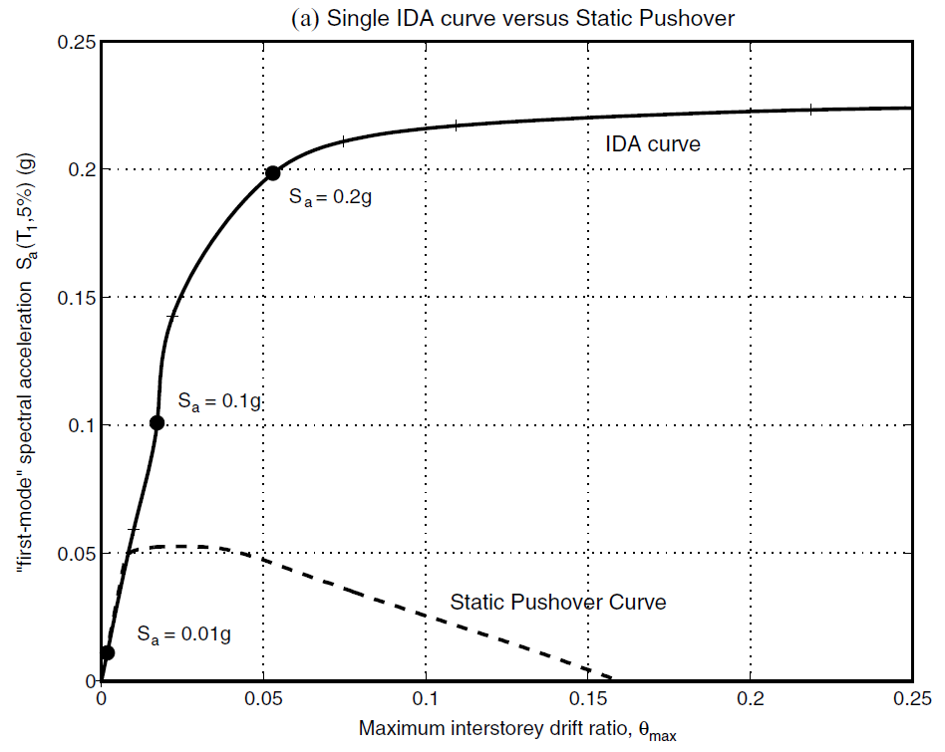
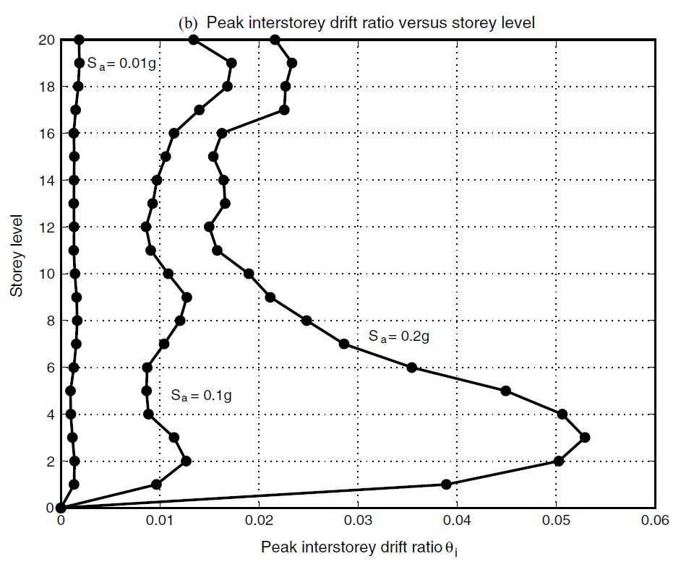
INTRODUCTION
SINGLE STATIC ANALYSIS
➔
INCREMENTAL SPO
SINGLE TIME-HISTORY ANALYSIS
➔
INCREMENTAL ONE

Slide 26
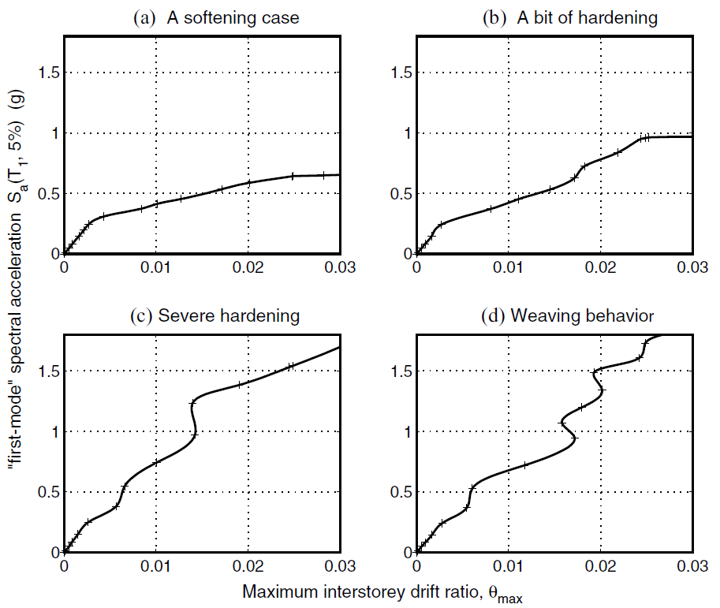
INFINITY
SOFTENS
0.2g
？
SOFTENING
&
HARDENING
EQUAL DISPLACEMENT
0.2g
Notes:
SOME GENERAL PROPERTIES

Slide 27
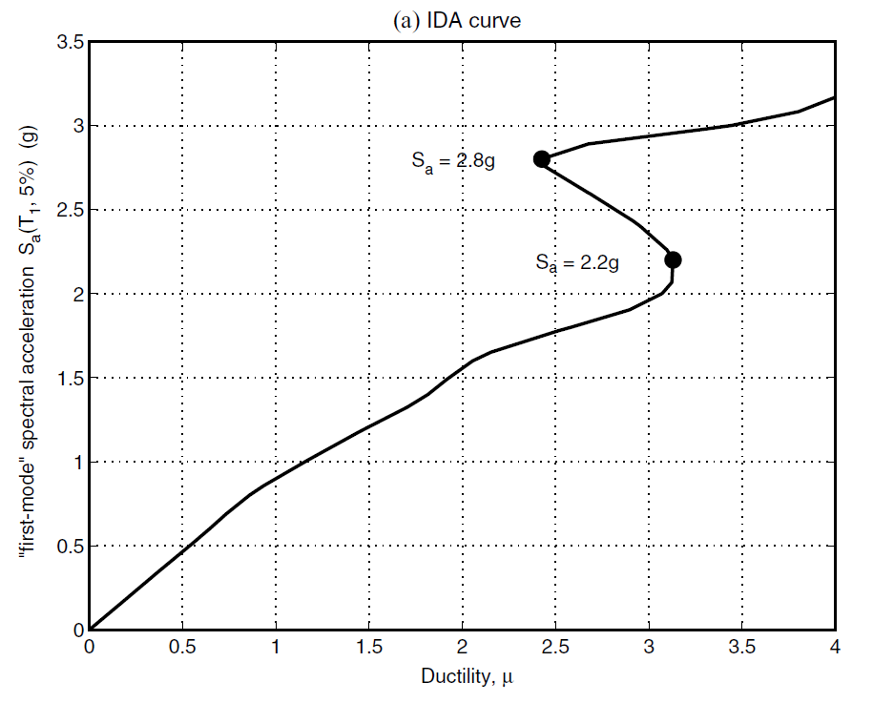
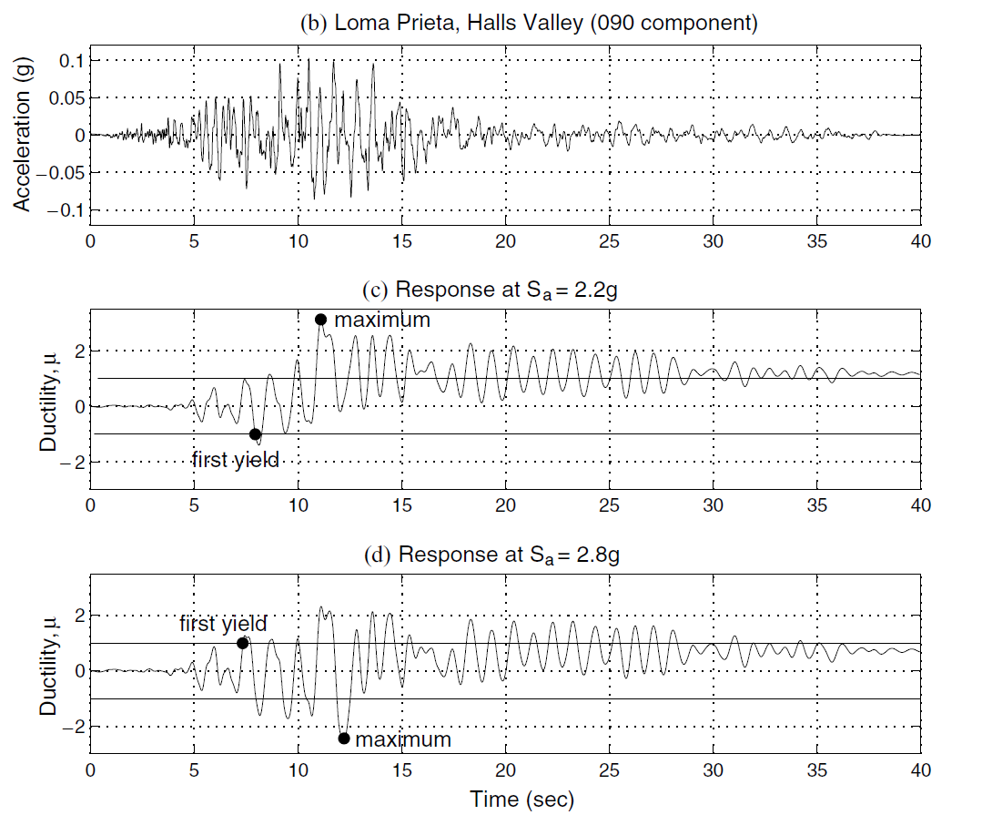
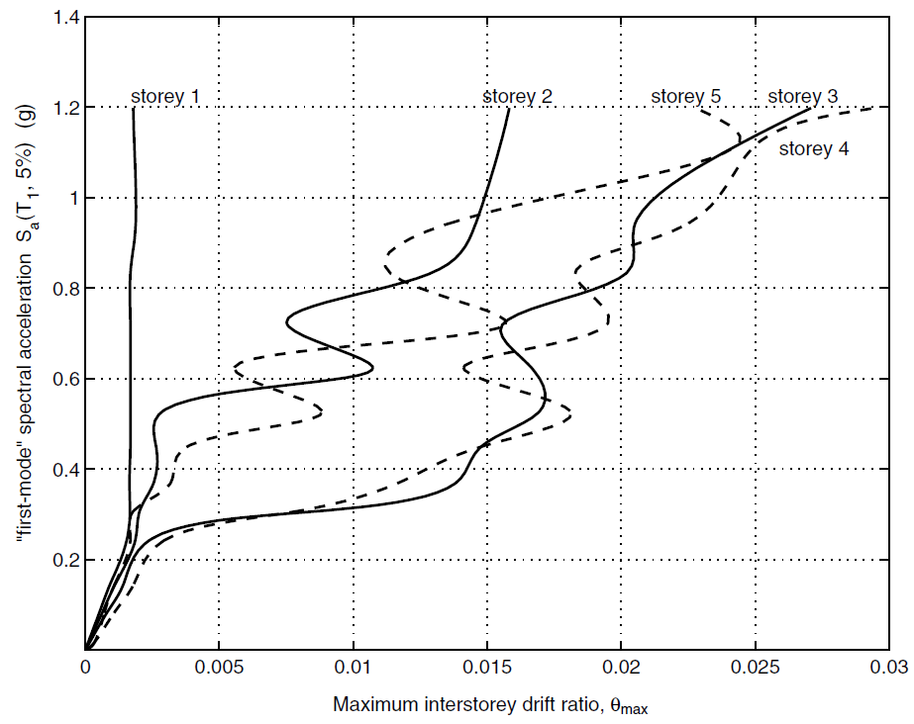
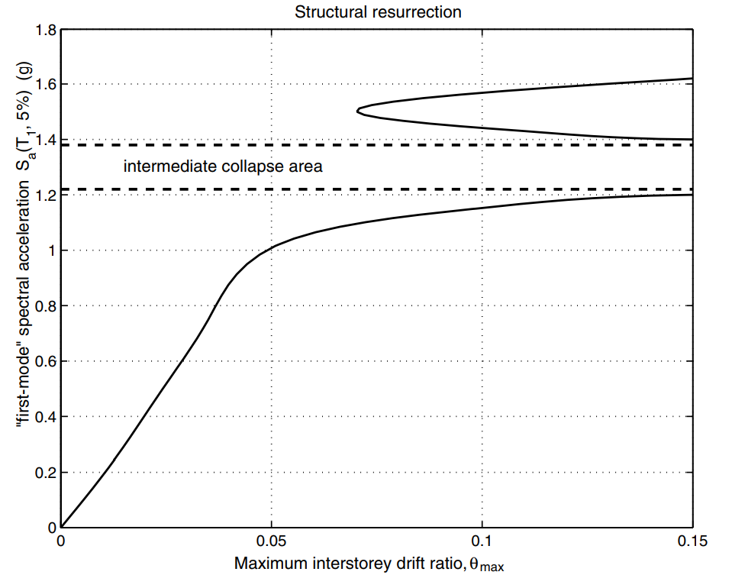
EARLIER YIELDING
FUSE
STRUCTURAL RESURRECTION

Slide 28
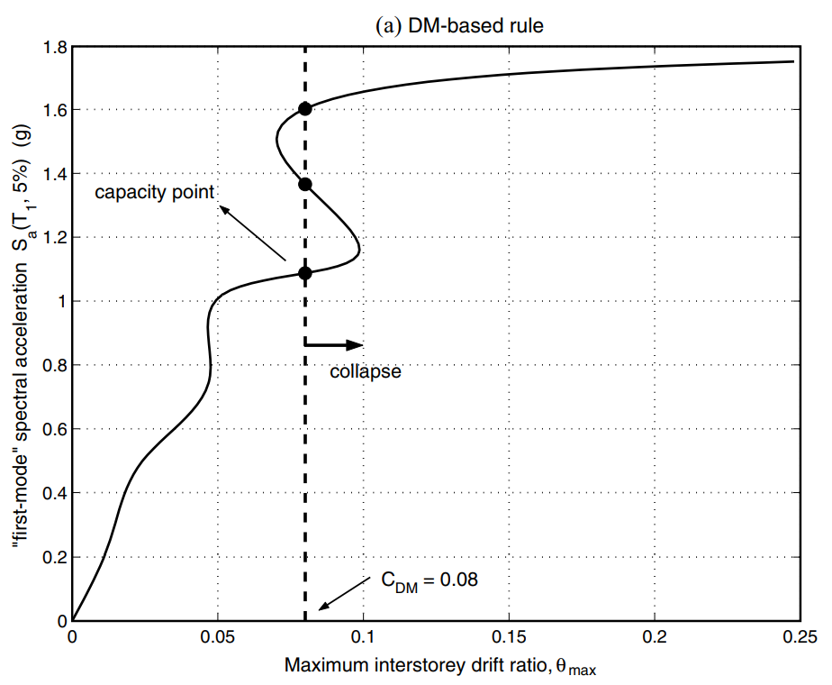
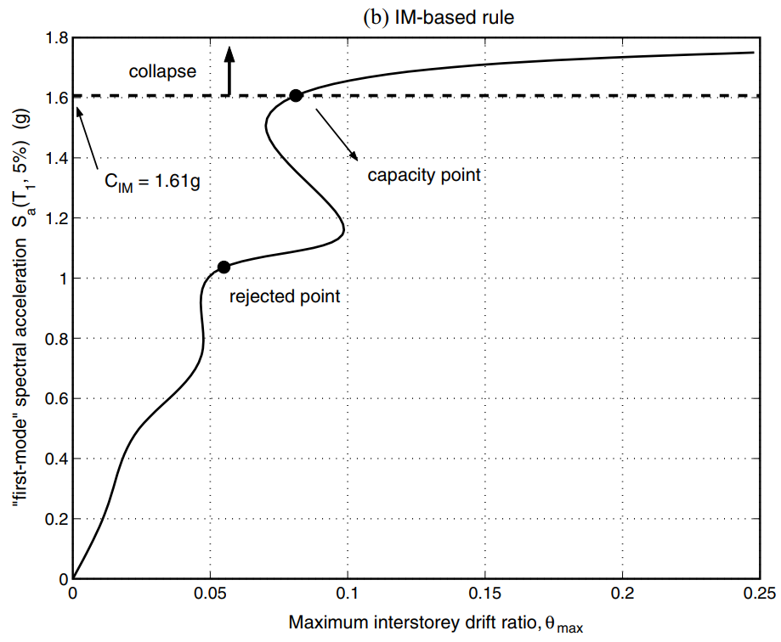
CAPACITY AND LIMIT-STATES
FEMA 20% TANGENT SLOPE APPROACH
Notes:
CAPACITY AND LIMIT-STATES

Slide 29
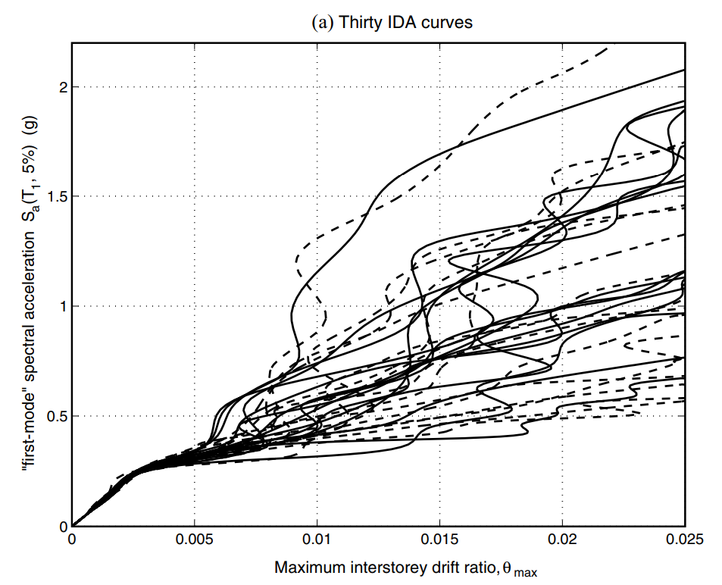
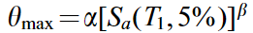
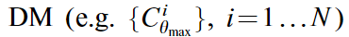
MULTI-RECORD
PARAMETRIC METHODS
NON-PARAMETRIC METHODS
MEAN MEDIAN
CAPACITY

Slide 30
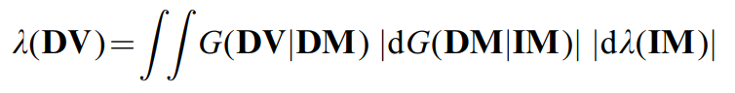
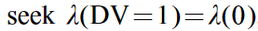
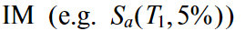
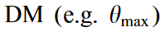
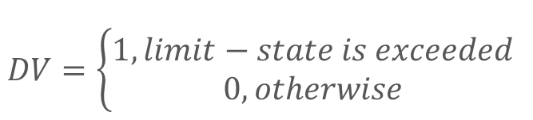
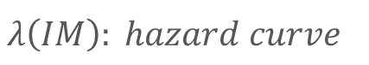
PBEE FRAMEWORK
$$DV=\left\{\begin{aligned}1, limit−state is exceeded \\ 0, otherwise\end{aligned}\right.$$
$$λ\left(IM\right): hazard curve$$
$$G\left(DM | IM\right):(conditional) complementary cumulative distribution$$

Slide 31
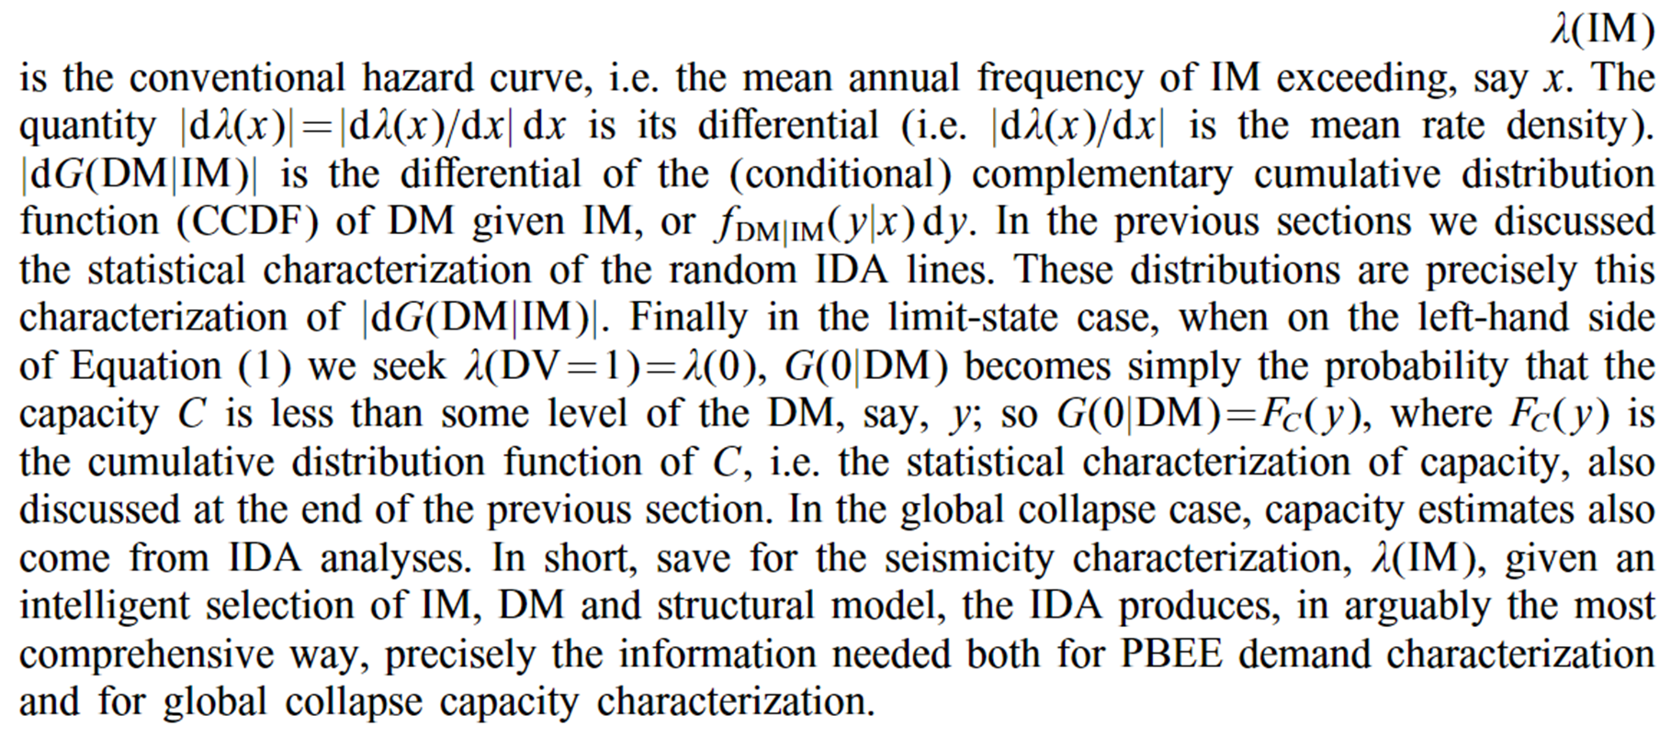

Slide 32
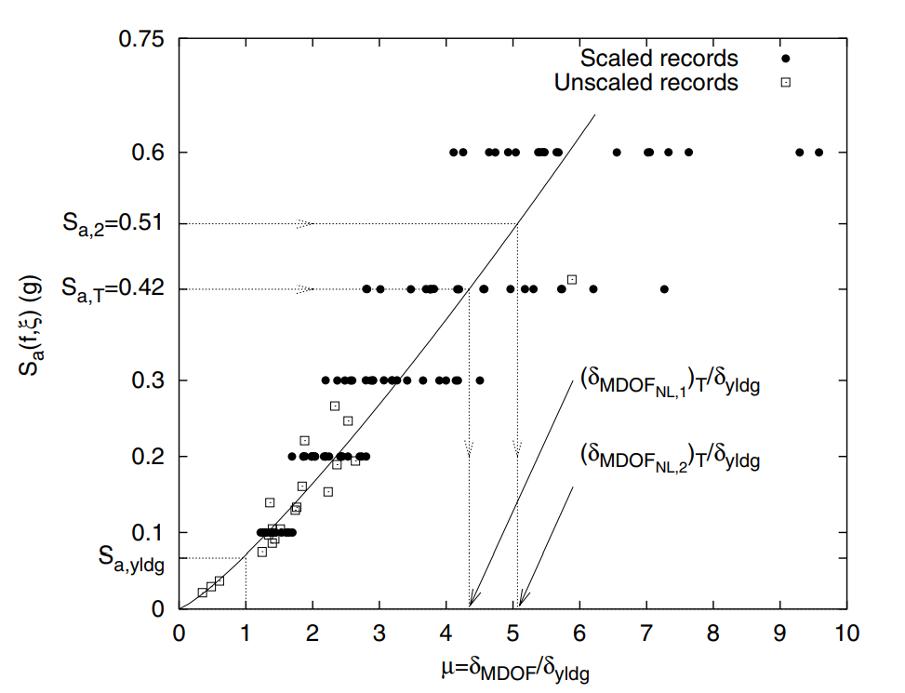
SCALING LEGITIMACY
ROOF DUCTILITY RESPONSE OF A
T₁= 1s
MDOF STEEL FRAME SUBJECTED TO
20 RECORDS
SCALED TO 5 LEVELS OF Sa(T₁,5%)

Slide 33
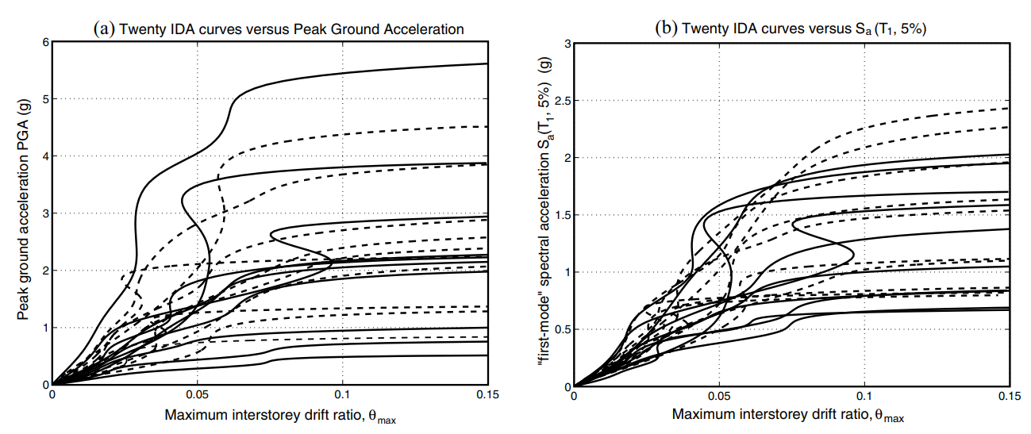
PGA
Sa(T₁,5%)

Slide 34
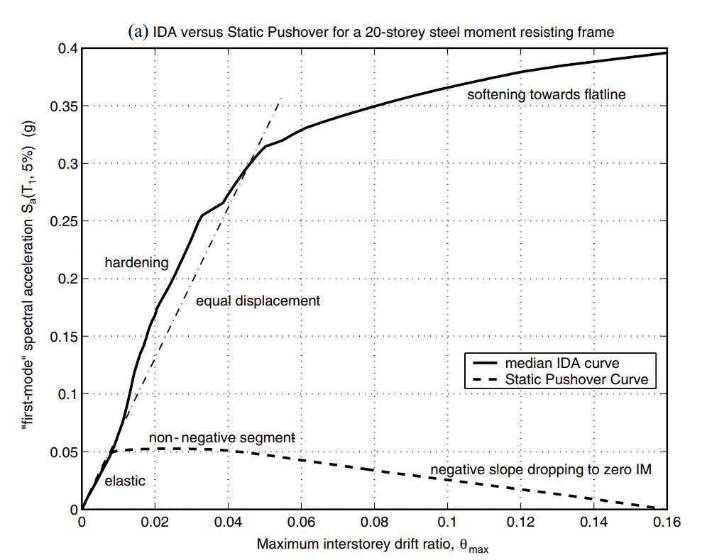
NON-LINEAR SPO
ELASTIC
➔
MATCH
NON-NEGATIVE
➔
EQUAL DISPLACEMENT
NEGATIVE
➔
SOFTENING

Slide 35
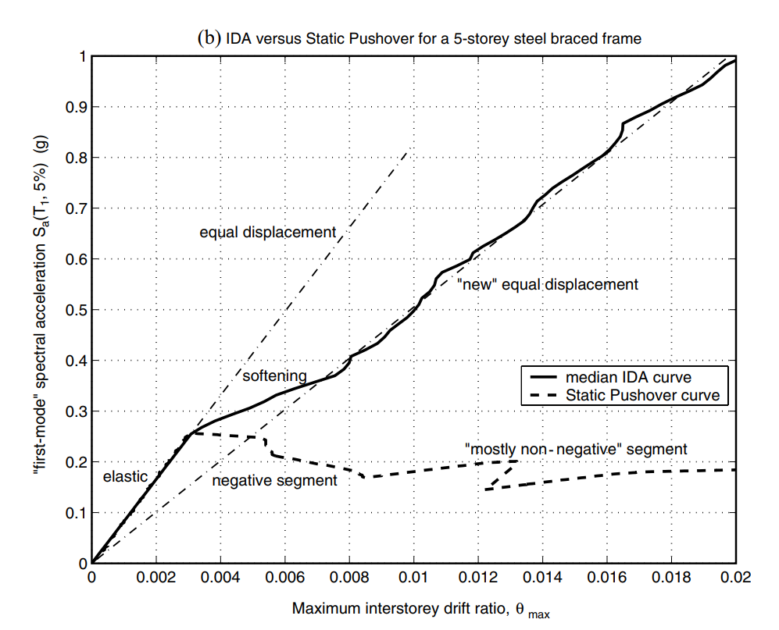
NON-LINEAR SPO
NEGATIVE => NON-NEGATIVE
NEW
EQUAL DISPLACEMENT
➔

Slide 36
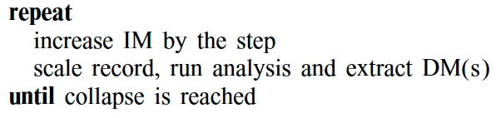
IDA ALGORITHMS

Slide 37
IDA ALGORITHMS

Slide 38
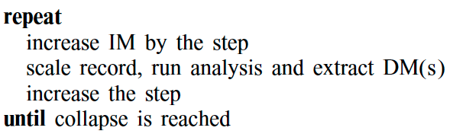
HUNTING PHASE

Slide 39
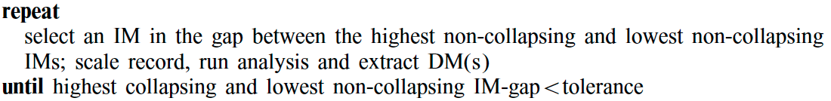

Slide 40
Furthermore, to improve upon the capacity resolution, a simple enhancement is to add a step-reducing routine, for example bisection, when collapse (e.g. non-convergence) is detected, so as to tighten the bracketing of the flatline.
This will enable a prescribed accuracy for the capacity to be reached regardless of the demand resolution.

Slide 41
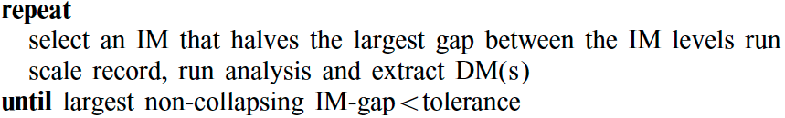

Slide 42
CONCLUSIONS
PROPERTIES
LEGITIMACY
ALGORITHMS
Discontinuities, 'flatlining‘, resurrection and
the variability from record to record.
Addressed the question of 'legitimacy' of scaling records and the relationships between IDAs and the SPO Analysis.
Algorithms presented here can reduce the number of non-linear runs per record to a handful

Slide 43
Roadmap
02/2016
04/2016
06/2016
Market Overview
Pre-Release
Launch
01/2016
03/2016
05/2016
Introduction
Partnerships
Beta

Slide 44

The problem you want to solve

Slide 45



Today’s solutions

Slide 46
Why it doesn’t work
Difficult to implement
Expensive for small businesses
Zero customization

Slide 47

Your solution

Slide 49
Your solution

Slide 50
Your solution

Slide 51
Your solution

Slide 53
Your solution

Slide 54
Awesome features
Awesome map feature
Awesome like feature
Awesome battery feature

Slide 55
Use case
1
2
3
4
5
Very Easy Step 1
Very Easy Step 2
Very Easy Step 3
Very Easy Step 4
Very Easy Step 5

Slide 56
Value Proposal
Make things really change
Make the world a better place
Offer one perfect answer
This is how we are going to make this happen in a beautiful way.
This is how we are going to make this happen in a beautiful way.
This is how we are going to make this happen in a beautiful way.

Slide 57
Market Sizing
$36b
$12b
$2b
Total World Market
Total US Market
Total FR Market
Source : source.io
Source : source.io
Source : source.io

Slide 58
Market Size over Time
Market Sizing (in €billions)

Slide 59
Market on Map
$1b
$2b

Slide 60
Why Now ?
Mobile Internet Usage

Slide 61


Customer Profiles
Young adults
25-35 years old
Students
15-20 years old

Slide 62
Competitors

Slide 63
AXIS 2
Your company
competitor
competitor
AXIS 1
AXIS 1
competitor
competitor
competitor
competitor
AXIS 2

Slide 64
 | YOUR COMPANY | COMPETITOR 1 | COMPETITOR 2 | COMPETITOR 3
feature 1
feature 2
feature 3
feature 4
feature 5
feature 6

Slide 65
Metrics
800
97%
94%
Paying users
Margin
Recurring users
$150,000
85,000
54
Monthly Recurring
Revenue
Users growing 45% per month
API Integrations

Slide 66
Conversion Rate
0,27%

Slide 67
Split Budget

Slide 68
Split Budget
75%
69%
30%
29%
29%
Marketing
Research
Sales
Design
Hiring

Slide 69
Forecast

Slide 70
Financial Table
 | 2016 | 2017 | 2018 | 2019 | 2020
Sales | 0 | 50 | 400 | 1000 | 3000
Revenue | - | $100 000 | $800 000 | $2 000 000 | $6 000 000
Gross Margin (%) | - | 49% | 51% | 53% | 58%
Expenses | - | $128 000 | $450 000 | $800 000 | $1 200 000
Net Profit | - | $-28,000 | $350 000 | $1 200 000 | $4 800 000
Profit Margin (%) | - | -28% | 44% | 60% | 80%

Slide 71
Outstanding Founders
Dave Lopper CTO
Come Mertial CEO
Tran Zition
CPO
Google
Facebook
Stanford
Microsoft
SalesForce
HEC Paris
Uber
Awwwards
MIT Media Lab

Slide 72
Advisors and Directors
Jérémy Vestiaire
Financial Advisor
Goldman Sachs
Jey Bestelgram
Product Advisor
Amazon
Oudam Dadam
Machine Learning Enthousiast
SpaceX
Tomy Lamousse
PR Advisor
Mashable
Lam Ontarelle
UX Contributor
Slidor
Renaude Yorella
Board Member
Sequoia Capital
Laurence Marc
Board Member
Accel Partners
Vince Lacluze
UI Director
Snapchat

Slide 73
Roadmap
02/2016
04/2016
06/2016
Market Overview
Pre-Release
Launch
01/2016
03/2016
05/2016
Introduction
Partnerships
Beta

Slide 74
Say you want to make the world a better place

Slide 75
Icons

Slide 76
Icons

Slide 77
Social

Slide 78
Red
Pink
Purple
Deep Purple
Indigo
Blue
Light Blue
Cyan
Teal
Green
Light Green
Lime
Yellow
Amber
Orange
Deep Orange
50
50
50
50
50
50
50
50
50
50
50
50
50
50
50
50
100
100
100
100
100
100
100
100
100
100
100
100
100
100
100
100
200
200
200
200
200
200
200
200
200
200
200
200
200
200
200
200
300
300
300
300
300
300
300
300
300
300
300
300
300
300
300
300
400
400
400
400
400
400
400
400
400
400
400
400
400
400
400
400
500
500
500
500
500
500
500
500
500
500
500
500
500
500
500
500
600
600
600
600
600
600
600
600
600
600
600
600
600
600
600
600
700
700
700
700
700
700
700
700
700
700
700
700
700
700
700
700
800
800
800
800
800
800
800
800
800
800
800
800
800
800
800
800
900
900
900
900
900
900
900
900
900
900
900
900
900
900
900
900
A100
A100
A100
A100
A100
A100
A100
A100
A100
A100
A100
A100
A100
A100
A100
A100
A200
A200
A200
A200
A200
A200
A200
A200
A200
A200
A200
A200
A200
A200
A200
A200
A400
A400
A400
A400
A400
A400
A400
A400
A400
A400
A400
A400
A400
A400
A400
A400
A700
A700
A700
A700
A700
A700
A700
A700
A700
A700
A700
A700
A700
A700
A700
A700

Slide 79
Gradient 1

Slide 80
Gradient 2

Slide 81
Gradient 3

Slide 82
Gradient 4

Slide 83
Gradient 5

